Slide 1

Air Quality Intelligence System using Big Data and Python
FDE Project Review-2
 | Under the Guidance of Dr. N. Sirisha Professor, Department of Computer Science and Engineering, KLH CSE Bowrampet Campus
Team Members M. Sri Ram Madhav 2420030273 D. Dinesh Kumar 2420030169 T. Vallabh 2420030029

Slide 2
Problem Statement
Air quality data remains scattered across government monitoring stations, satellite feeds, industrial sensors, and traffic sensors, with no unified view of regional pollution levels.
Manual, station-based reporting delays the detection of pollution spikes, often surfacing hazardous trends only after public exposure has already occurred.
Existing air-quality portals mostly offer static, after-the-fact AQI reports rather than proactive, predictive pollution forecasts.
Citizens and policymakers lack real-time alerts for hazardous pollution spikes, unhealthy AQI zones, or early warning signs across regions.
There is no single, scalable platform that connects meteorological, industrial, traffic, and satellite data to assess air-quality risk in real time.
There is a need for a secure, scalable, Big-Data-driven analytics platform that can process high-volume sensor data and support timely, data-driven air-quality decisions.
An Air Quality Intelligence System (AQIS) is proposed as a Big-Data and Python-based analytics and forecasting platform to close this gap.

Slide 3
Real-World Relevance & Motivation
Rising Air Pollution Levels
Fragmented AQI Data Sources
Manual, Delayed Reporting
Pollution Spikes Too Late
No Unified AQI View
Weak Decision Support
Need for Real-Time Big Data
Motivation: One Unified AQI Platform

Slide 4
Objectives
Build a single Big-Data platform integrating multi-source air-quality data ingestion (government monitors, satellite feeds, IoT/traffic sensors) using a scalable streaming pipeline (Kafka/Spark).
Provide Python-based machine-learning models for AQI forecasting, pollutant-level prediction, and pollution-source classification.
Implement interactive dashboards for real-time air-quality visualization across regions, cities, and monitoring zones.
Automate alerts for hazardous AQI threshold breaches, sudden pollution spikes, and unusual sensor readings.
Ensure interoperability through open data APIs (e.g., CPCB, OpenAQ, satellite feeds) for integration with government and research systems.
Reduce manual monitoring effort and improve early warning and public response through intelligent automation and predictive analytics.

Slide 5
Expected Outcomes
A unified, scalable Big-Data platform that ingests, processes, and visualizes air-quality data from multiple sources in real time.
Earlier detection of pollution spikes and hazardous AQI zones through predictive analytics rather than static, after-the-fact reporting.
Interactive dashboards that give citizens and policymakers real-time visibility into regional and city-level air-quality risk.
Reduced manual monitoring effort through automated data ingestion, forecasting, and alerting.
A scalable, interoperable system that can extend to new sensors, pollutants, and regions over time.

Slide 6
Literature Survey
Authors | Title of the Paper | Methodology | Inferences | Limitation/Future work
Rahman, Hasan, Akter & Mia (2026) | Air Pollution Monitoring and Prediction using Big Data Analytics and Machine Learning | Applied SVM, regression, XGBoost, ANN, and a stacked ensemble to multi-year hourly pollution and meteorological data from a Bangladeshi district. | The ensemble classified air quality with about 99.6% accuracy and reliably predicted PM2.5, PM10, NO2, SO2, CO, and O3 levels. | Single-region case study with heavy ensemble computation; limited testing on live, streaming Big-Data infrastructure.
Kang, Gao, Chiao, Lu & Xie (2018) | Air Quality Prediction: Big Data and Machine Learning Approaches | Compared four regression techniques for pollution prediction on IoT sensor data, executed on Apache Spark for scalability. | Big-Data frameworks such as Spark improve processing time for large-scale pollution datasets and support smart-city monitoring. | Focus limited to processing-time benchmarking; no integration with a live dashboard or alerting system.
Özüpak, Alpsalaz & Aslan (2025) | Air Quality Forecasting Using Machine Learning: Comparative Analysis and Ensemble Strategies | Evaluated ten regression models (XGBoost, LightGBM, Random Forest, CatBoost, SVR, and others) with Bayesian hyperparameter optimization on hourly pollutant sensor data. | Tuned ensemble models, especially Bayesian-optimized SVR, substantially improved AQI forecasting accuracy over baseline models. | Single urban dataset spanning one year; high computational cost; not evaluated at Big-Data scale.
Rajesh, Ganesh Babu, Moorthy & Easwaramoorthy (2025) | Machine Learning-Driven Framework for Real-Time Air Quality Assessment and Predictive Environmental Health Risk Mapping | Integrated fixed/mobile sensors, meteorological, satellite, and demographic data with Random Forest, Gradient Boosting, XGBoost, and LSTM models in a cloud-based framework. | Multi-source integration enables high-accuracy, real-time pollutant classification and health-risk mapping across diverse environments. | Data heterogeneity and sensor-calibration challenges; not yet validated with real-world sensor deployment or public dashboards.

Slide 7
Proposed Solution: How AQIS Addresses the Gap
AQIS (Air Quality Intelligence System) is proposed as a unified Big-Data and Python-based air-quality analytics and forecasting platform that combines real-time multi-source data ingestion, distributed processing, and machine-learning-driven prediction with an interactive decision-support dashboard. By pairing scalable streaming pipelines (Kafka/Spark) with Python-based forecasting models and role-based dashboards, AQIS moves air-quality monitoring from static, after-the-fact reporting toward proactive, real-time decision support.
Research Gap | How AQIS Addresses It
Single-function tools address only prediction, only visualization, or only Big-Data benchmarking. | AQIS unifies data ingestion, distributed processing, forecasting, and visualization in one platform.
High model accuracy in reviewed studies, but tested on static datasets rather than live streaming infrastructure. | Built on a Kafka/Spark streaming pipeline that applies Python-based ML models to live sensor and satellite feeds.
Big-Data benchmarking studies stop at processing speed and are not connected to a public dashboard. | Processed data flows directly into an interactive, real-time AQI dashboard for citizens and officials.
Tuned ensemble models are computationally heavy and evaluated on a single city or dataset. | Lightweight, scalable Python forecasting models are designed to generalize across cities and regions.
No single system spans real-time ingestion, prediction, and public decision support. | A full pipeline: ingestion → distributed processing → forecasting → dashboard → automated alerts.

Slide 8
Technology Stack
Programming & ML
• Python
• Machine Learning
Big Data & Streaming
• Apache Spark
• Apache Kafka
Storage & Caching
• Data Lake
• InfluxDB
• Redis
Data Sources & Visualization
• OpenAQ / CPCB APIs
• IoT & Satellite Data
• Interactive AQI Dashboard

Slide 9
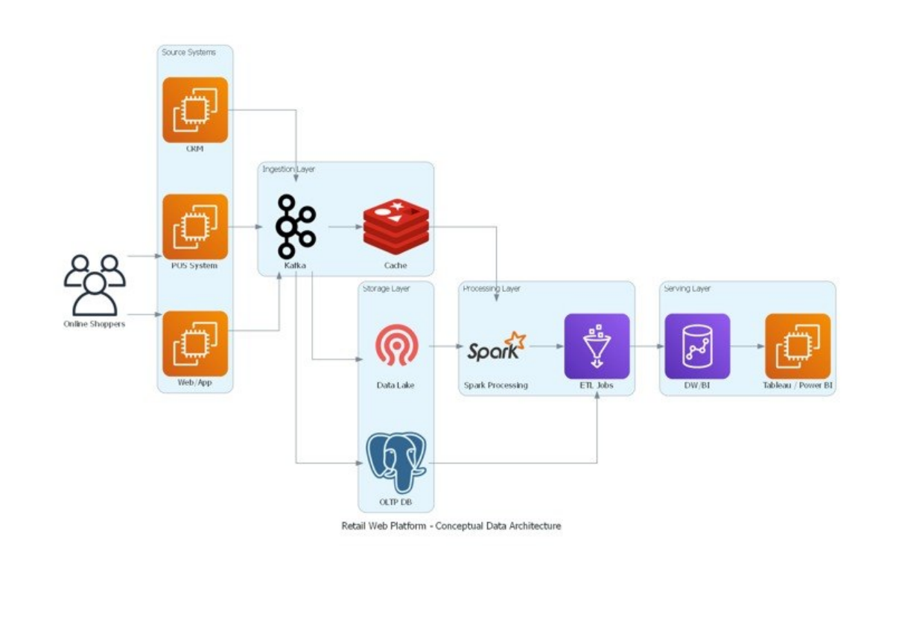
System Architecture
Retail Web Platform – Conceptual Data Architecture (reference pattern)

